Slide 1

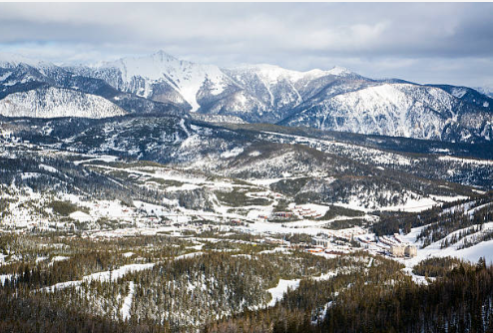
Guided Capstone project Presentation
Ron hankey​

Slide 2

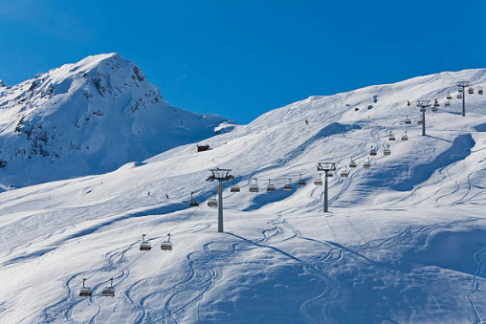
Agenda
Introduction
Problem Identification
Analysis
Modeling
Conclusion

Slide 3
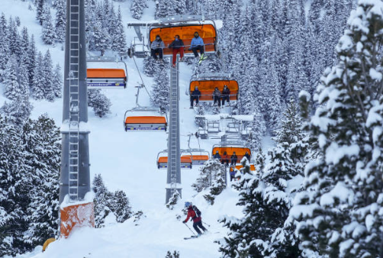

Introduction
Reassess Big Mountain Resort's ticket pricing strategy in light of its market position and offerings.

Slide 4
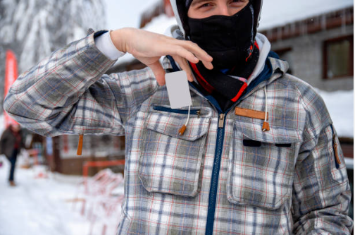
Problem Statement
The goal is to determine an optimal ticket pricing strategy for Big Mountain Resort.
Project success can be measured by evaluating the impact of the recommended pricing strategy, along with cost-cutting measures, on profitability.
This strategy aligns with the resort's goal of implementing a more data-driven business approach and needs to be implemented within the next year.

Slide 5
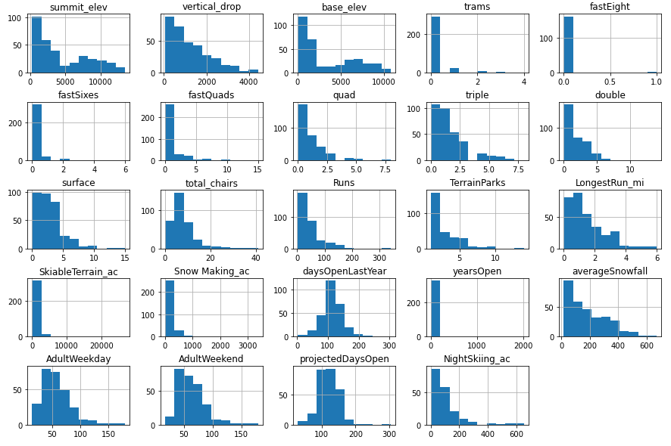
Analysis
Distribution Of Feature Values

Slide 6
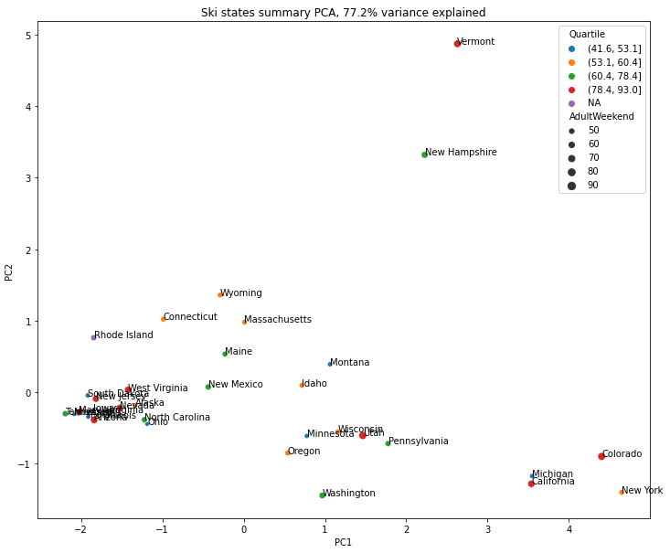
Analysis
Distribution Of Ticket Prices by State

Slide 7
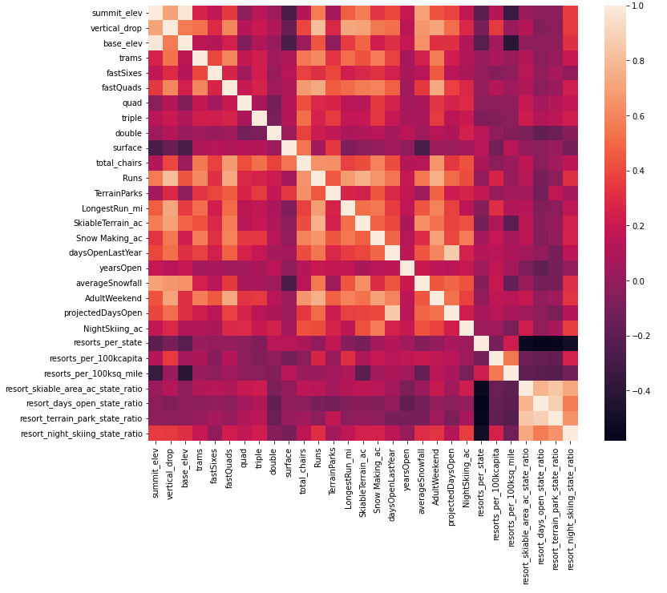
Analysis
Feature correlation heatmap

Slide 8
Modeling
Impute missing values with median
Scale the data
Make predictions using the model on both train and test splits
Assess model performance
R-Squared - (0.8177988515690604, 0.7209725843435146)
Impute missing values with the mean
Assess model performance
Scale the data
Make predictions using the model on both train and test splits
Assess model performance
R-Squared - (0.8170154093990025, 0.7163814716959958)

Slide 9
Modeling
Impute missing values with median
Scale the data
Make predictions using the model on both train and test splits
Assess model performance
R-Squared - (0.8177988515690604, 0.7209725843435146)
Impute missing values with the mean
Assess model performance
Scale the data
Make predictions using the model on both train and test splits
Assess model performance
R-Squared - (0.8170154093990025, 0.7163814716959958)

Slide 10
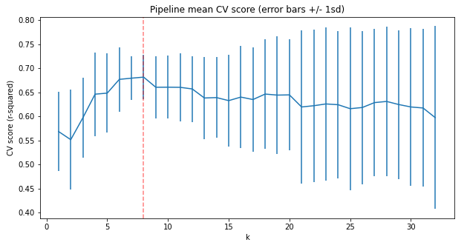
Modeling
Hyperparameter Tuning – Linear Model

Slide 11
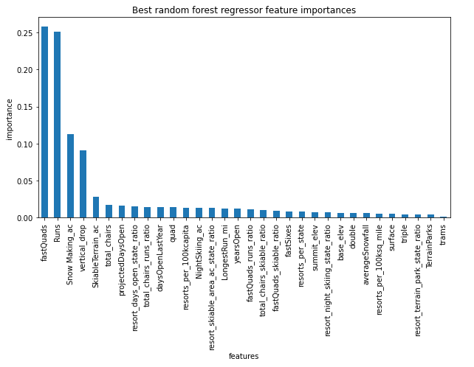
Modeling
Hyperparameter Tuning – Random Forest

Slide 12
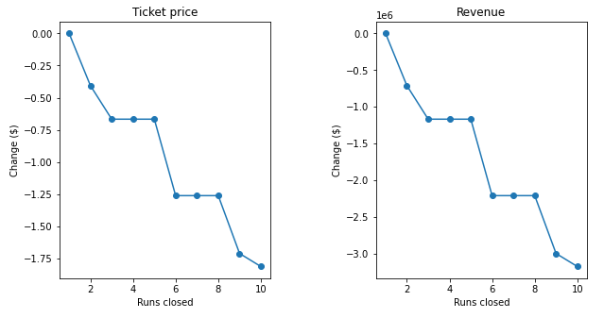
Modeling
Close up to 10 of the least used runs.

Slide 13
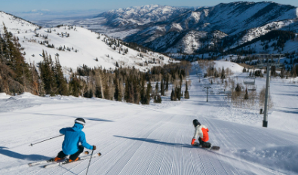
Summary
Increase ticket price from current of $81.00 to $85.34 and monitor impact on revenue
Increase ticket price up to $106.40
Initially close 1 run to reduce operational cost
Closes additional runs if revenue was not impacted
Add run with 150 foot additional drop and chair lift

Slide 14

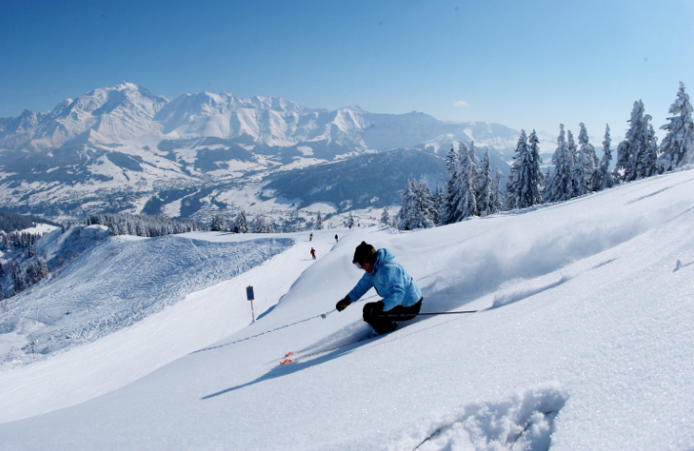

Thank you
Ron Hankey

